Slide 1
Chapter 10:
Computer Graphics
Computer Science: An Overview
Tenth Edition
by
J. Glenn Brookshear

Slide 2
Chapter 10: Computer Graphics
10.1 The Scope of Computer Graphics
10.2 Overview of 3D Graphics
10.3 Modeling
10.4 Rendering
10.5 Dealing with Global Lighting
10.6 Animation

Slide 3
2D Versus 3D Graphics
2D Graphics: Deals with manipulating two-dimensional images
3D Graphics: Deals with producing and displaying images of three-dimensional virtual scenes.

Slide 4
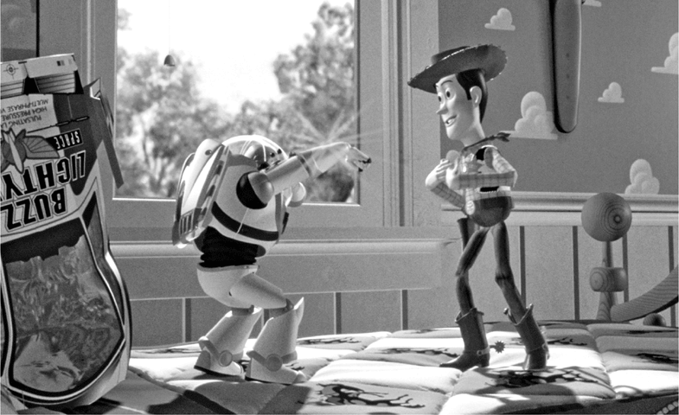
Figure 10.1 A “photograph” of a virtual world produced using 3D graphics (from Toy Story by Walt Disney Pictures/Pixar Animation Studios) © Corbis/Sygma

Slide 5
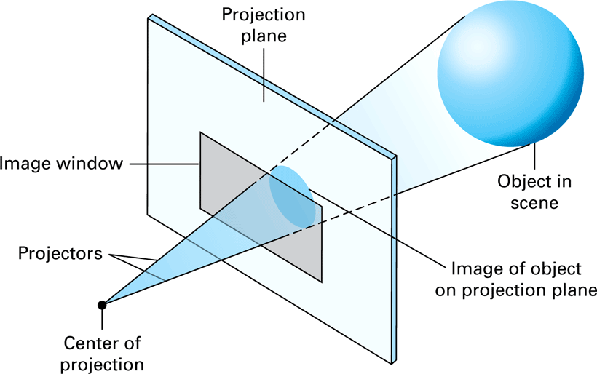
Figure 10.2 The 3D graphics paradigm

Slide 6
Modeling Objects
Shape: Represented by a polygonal mesh obtained from
  Traditional mathematical equations
  Berzier curves and surfaces
  Procedural models
  Other methods being researched
Surface: Can be represented by a texture map

Slide 7
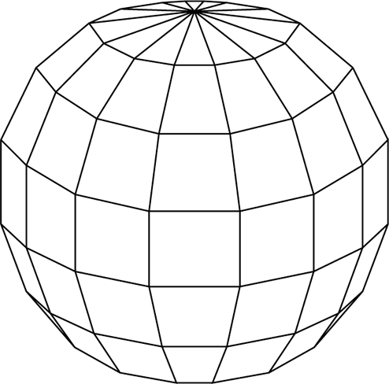
Figure 10.3 A polygonal mesh for a sphere

Slide 8
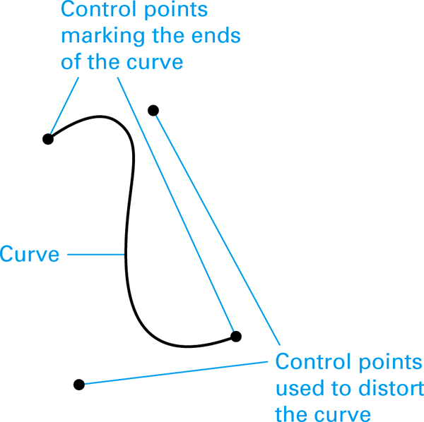
Figure 10.4 A Bezier curve

Slide 9
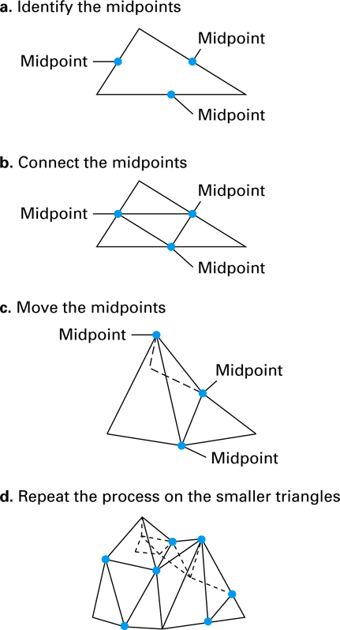
Figure 10.5 Growing a polygonal mesh for a mountain range

Slide 10
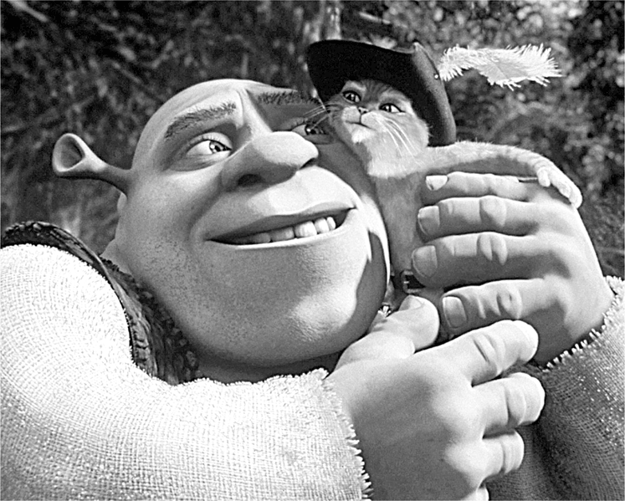
Figure 10.6 A scene from Shrek 2 by Dreamworks SKG (© Dreamworks/The Kobal Collection)

Slide 11
Reflection Versus Refraction
Reflection: Light rays bounce off surface.
  Specular light
  Diffuse light
  Ambient light
Refraction: Light rays penetrate surface.

Slide 12
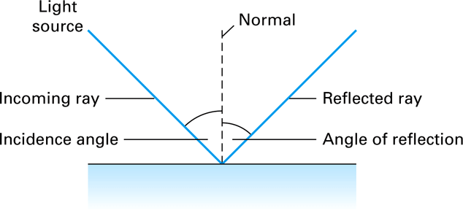
Figure 10.7 Reflected light

Slide 13
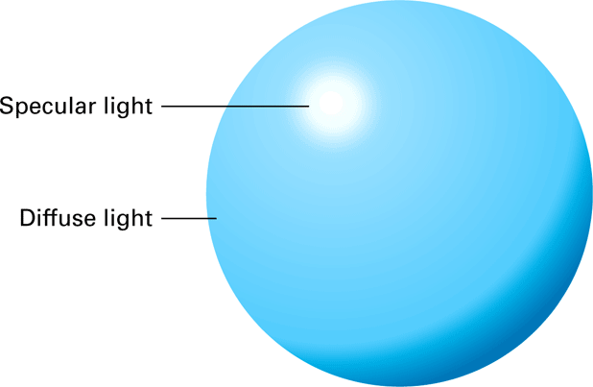
Figure 10.8 Specular versus diffuse light

Slide 14
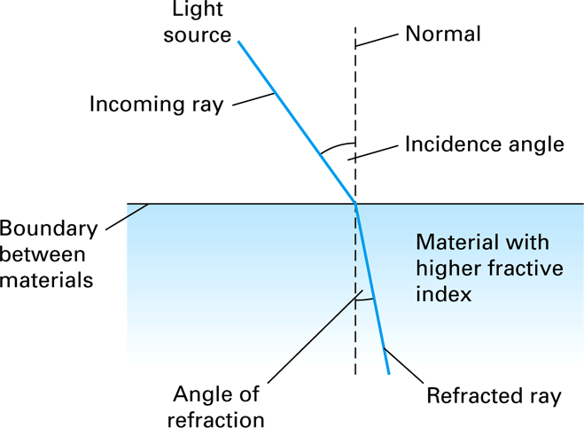
Figure 10.9 Refracted light

Slide 15
Rendering
Clipping: Restricts attention to objects within view volume
Scan Conversion: Associates pixel positions with points in scene
Shading: Determines appearance of points associated with pixels

Slide 16
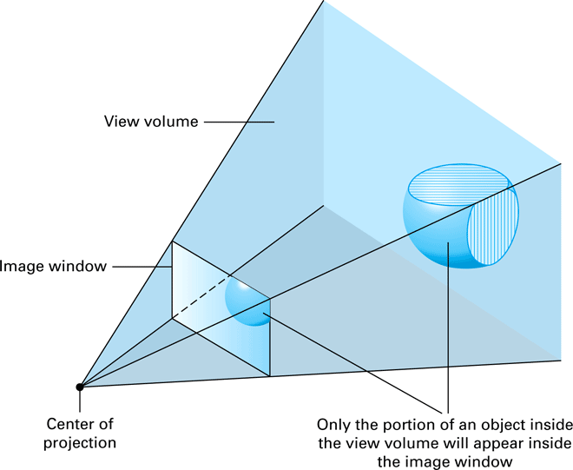
Figure 10.10 Identifying the region of the scene that lies inside the view volume

Slide 17
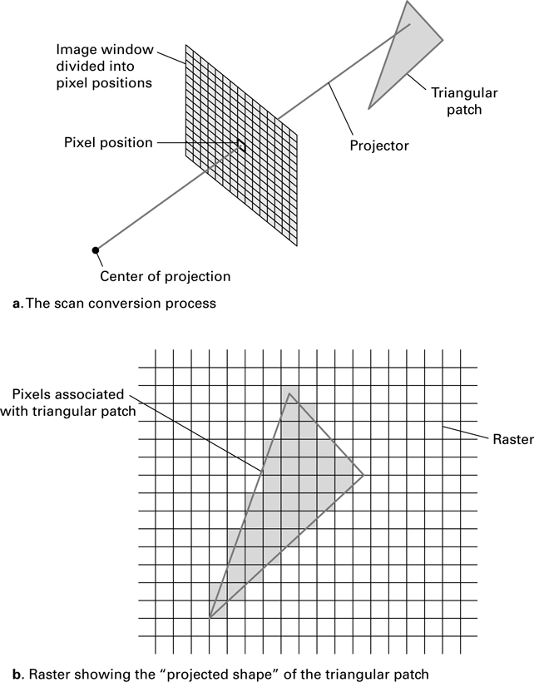
Figure 10.11 The scan conversion of a triangular patch

Slide 18
Shading Techniques
Flat Shading: Creates faceted appearance
Gouraud and Phong Shading: Creates smooth, rounded appearance
Bump Mapping: Creates bumpy, rounded appearance

Slide 19
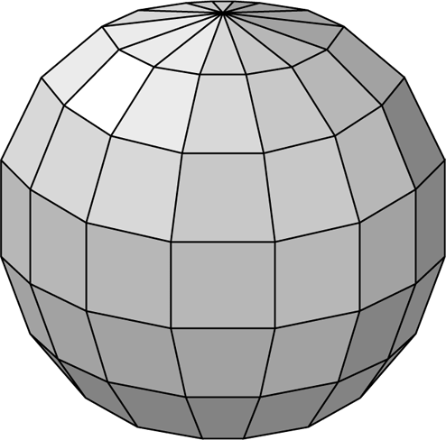
Figure 10.12 A sphere as it might appear when rendered by flat shading

Slide 20
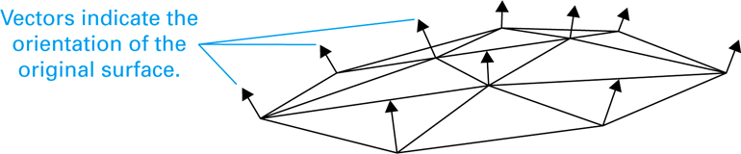
Figure 10.13 A conceptual view of a polygonal mesh with normal vectors at its vertices

Slide 21
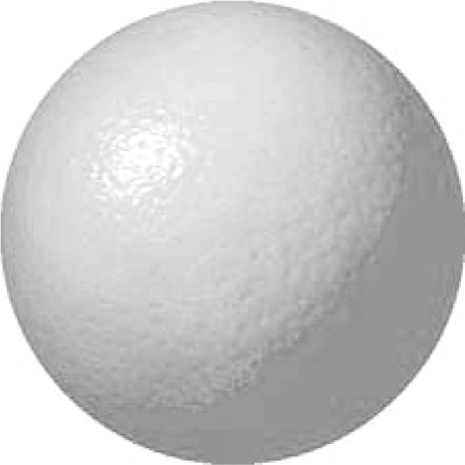
Figure 10.14 A sphere as it might appear when rendered using bump mapping

Slide 22
Rendering Pipeline
Consists of traditional algorithms for clipping, scan conversion, and shading
Often implemented in firmware
Used as an abstract tool in graphics applications

Slide 23
Local Versus Global Lighting
Local Lighting Model: Does not account for light interactions among objects
Global Lighting Model: Accounts for light interactions among objects
  Ray Tracing
  Radiosity

Slide 24
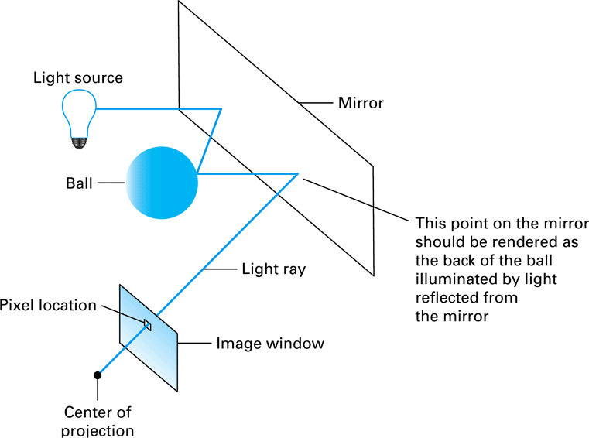
Figure 10.15 Ray tracing

Slide 25
Animation
Storyboard: A sequence of sketches summarizing the entire animation
Frame: One of many images used to create animation
Key Frames: Frames capturing the scene at specified points in time
In-betweening: Producing frames to fill the gaps between key frames

Slide 26
Simulating Motion
Dynamics: Applies laws of physics to determine position of objects
Kinematics: Applies characteristics of joints and appendages to determine position of objects
  Avars
  Motion Capture

